Slide 1
Microsoft Azure Overview
Microsoft Research

Slide 2
What is the Cloud?
“An approach to computing that’s about internet scale and connecting to a variety of devices and endpoints.”
“Treating hardware and software resources as a utility.”
“A way to save a ton of money by only paying for what you need.”
“A way to scale huge when you need something done fast.”

Slide 3
On and Off
Cloud Computing Patterns
Inactivity
Period
On & off workloads (e.g. batch job)
Over provisioned capacity is wasted
Time to market can be cumbersome
Compute
t
Growing Fast
Compute
Successful services needs to grow/scale
Keeping up w/ growth is big IT challenge
Cannot provision hardware fast enough
t
Unpredictable Bursting
Compute
Unexpected/unplanned peak in demand
Sudden spike impacts performance
Can’t over provision for extreme cases
t
Predictable Bursting
Compute
Services with micro seasonality trends
Peaks due to periodic increased demand
IT complexity and wasted capacity
t
Notes:
Most researchers won’t care about cost; they will care about scaling their research or “pushing through a huge amount of analysis before a conference;” most researchers do not see the costs because it’s paid for through a grant; business examples are not relevant to most researchers; mention collaboration; as in “the cloud makes it easier for researchers to collaborate”

Slide 4
>250k
Greater than
1,500,000
>500m
Azure Active Directory Users
Active websites
SQL Databases in Azure
>1
>777
TRILLION storage
transactions per day
>80%
Fortune 500
Use Azure
MILLION
Developers registered with Visual Studio Online
>1.5
TRILLION messages/mo processed by
Azure IoT
>13
BILLION
authentications/wk

Slide 5



Azure Datacenter Regions
North America
Europe
Asia Pacific
N. Europe
Central US
N. Central US
W. Europe
Japan West
West US
China North
Japan East
East US
East US 2
Central India
China South
S Central US
E. Asia
S.E. Asia
West India
Brazil South
South India
Australia East
Australia Southeast
Notes:
Prepare to be asked about U.S. jurisdiction over international data centers; compare to Gmail if they “get grumpy” and don’t want to use Azure for this reason
Maybe a brief overview of security on the "world" slide. People think that the cloud is publicly visible (naïve users). Others might need to protect the IP of the companies they do research with (e.g., agricultural research funded by Monsanto). Talk about HIPAA compliance and/or government security compliance.

Slide 6
Cloud Service Patterns
IaaS
PaaS
SaaS
Applications
Applications
Applications
Data
Data
Data
Runtime
Runtime
Runtime
Middleware
Middleware
Middleware
Operating System
Operating System
Operating System
Infrastructure as a Service
Platform as a Service
Software as a Service
Virtualization
Virtualization
Virtualization
Servers
Servers
Servers
Storage
Storage
Storage
Networking
Networking
Networking

Slide 7
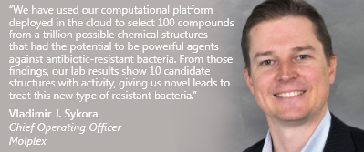
Clouds Against Disease
Azure Platform as a Service (PaaS) utilizing more than 100 Linux VMs
Molplex Pharmaceuticals, Newcastle University, and Microsoft Research
Employs custom molecular discovery software hosted on cloud-based HPC clusters to provide data on millions of chemical compounds to drug researchers
http://bit.ly/a4r-molplex
Aiming to Deliver New Drugs Faster at Less Cost in the Cloud

Slide 8
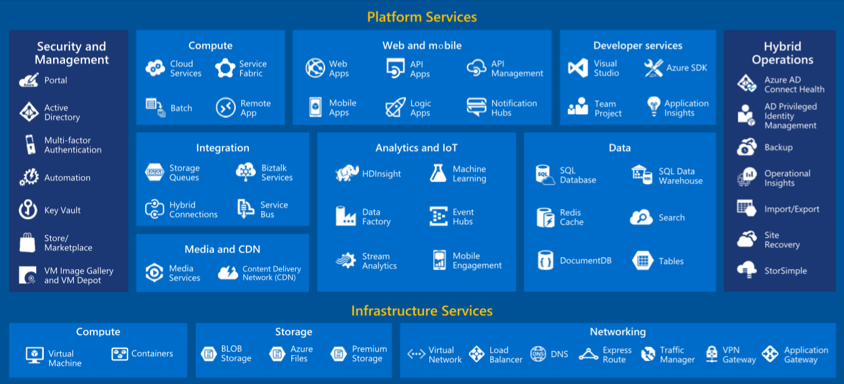
Azure Services

Slide 9
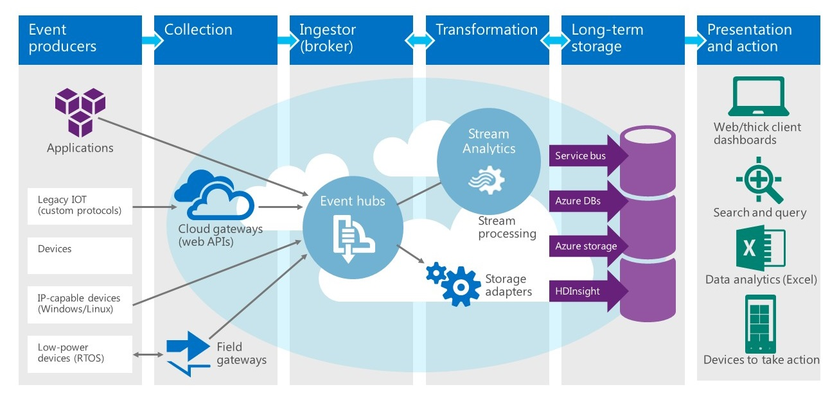
Azure Services Work Together

Slide 10
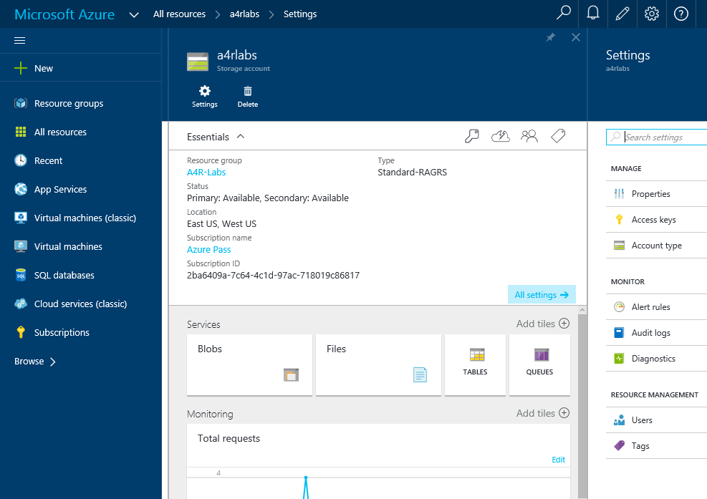
Azure Portal
https://portal.azure.com

Slide 11
Hands-On Lab!
Activating Your Azure Pass
Introduction HOL.html

